Slide 1
Critical Thinking
ISC

Slide 2
INTRODUCTION
Look at the following sentence and try to answer the questions:
TEN GRIFTY SNOLS CLOPPERED ALONG THE GRANCHY GAK.
Questions:
Who cloppered along the gak?
What did the snols do?
What kind of snols were they?
Where did they clopper?
Do you understand what the sentence means? Of course not. It is nonsense. Can you answer the questions? Yes.

Slide 3
It is possible to answer the questions related to a topic without thinking much.
Taking this into consideration, what we want is to our ability to understand, analyze and evaluate the information presented.
Attend to their own thinking process and avoid thinking errors is crucial.
Critical thinking skills: YES
because it serves a very important purpose: to prepare you for a world that is different from the one in the classroom.

Slide 4
Let’s take a look at some quotes on critical thinking
It is the mark of an educated mind to be able to entertain thought without accepting it. (Aristotle)
Chỉ có trình độ của một người có học mới có thể thấu cảm được tư tưởng (quan niệm của người khác) mà không chấp nhận hay cho đó là đúng hay sai.
Doubt is not a pleasant condition, but certainty is absurd. (Voltaire)
Nghi ngờ không phải một trạng thái dễ chịu, nhưng tin chắc thì thật ngu xuẩn.

Slide 5
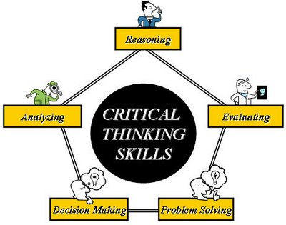
WHAT IS CRITICAL THINKING?
Critical thinking is a combination of skills:
Analyzing
Evaluating
Reasoning
Problem Solving
Decision Making

Slide 6
AND WHO IS A CRITICAL THINKER?
A critical thinker is someone who explores and considers as many possibilities as they can.
Their thinking is not bound by rules, and they try their best not to use emotions to justify their ideas.
A critical thinker knows that they often have to follow rules, but is able to think outside them… Because many commonly accepted things and ideas might, in fact, be wrong.

Slide 7
Learning to think critically means:
Understanding that our way is not the only way. There is a whole world of people who think and understand things differently;
Being sceptical and suspicious, active, not passive;
Developing a positive self-concept and attitude towards learning;
Looking at a topic more closely- discovering and exploring;
Getting engaged in discussion with others, negotiating and cooperating;

Slide 8
Learning to think critically means (cont.):
Bringing together ideas and making connections;
Testing out different alternatives and trying multiple perspectives;
Developing independence and problem-solving skills;
Respecting and understanding cultural diversity;
Looking for solutions that will work today and that will hopefully make tomorrow’s challenges easier.

Slide 9
CONCLUSION
Guided in this way, we will try to find our own answers to the questions we face every day in the classroom.
Answers which we care about.
Critical thinking creates a meaningful learning process so that we can remember long after we leave a classroom.

Slide 10
How to think rather what to think;
Be aware that we are important as individuals and our ideas and decisions are of great value;
Frequently asking WHY? in a non-threatening way; Continuously emphasizing existence of alternative points of view and tolerating ambiguity;
Give time to think about questions and situations;
Find clues to develop skills instead of reading available answers;
Encouraging working with clues to make intelligent guesses;
Learning beyond the course book and beyond the test if necessary.

Slide 11
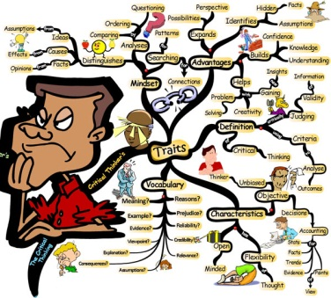
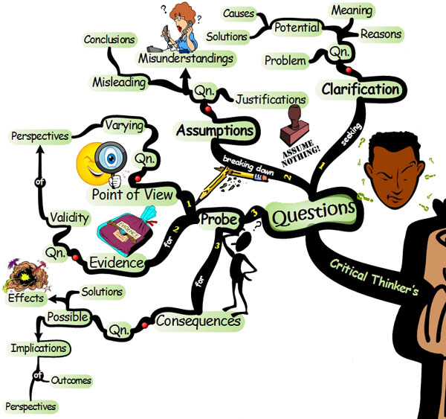

Slide 12
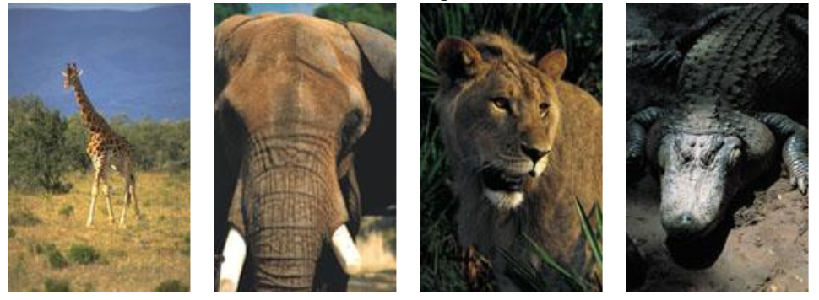
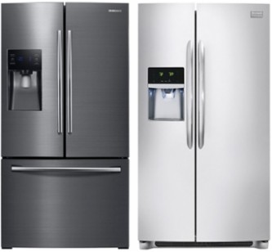
Critical Thinking Exercise 1

Slide 13
Answer each question in order
How do you put a giraffe into your refrigerator?
How do you put an elephant into your refrigerator?
The Lion King is hosting an animal conference. All the animals attend - except one. Which animal does not attend?
There is a river you must cross but it is used by crocodiles and you do not have a boat. How do you manage it?

Slide 14
Answer Sheet
1. How do you put a giraffe into your refrigerator?
The correct answer to question number 1 is: Open the refrigerator, put in the giraffe, and close the door. This question tests whether you tend to do simple things in an overly complicated way.
2. How do you put an elephant into your refrigerator?
Did you say, Open the refrigerator, put in the elephant, and close the refrigerator? Wrong answer. Correct answer: Open the refrigerator, take out the giraffe, put in the elephant and close the door. This tests your ability to think through the repercussions of your previous actions.
3. The Lion King is hosting an animal conference. All the animals attend - except one. Which animal does not attend?
Correct Answer: The elephant. The elephant is in the refrigerator. You just put him in there. This tests your memory. Okay, even if you did not answer the first three questions correctly, you still have one more chance to show your true abilities.
4. There is a river you must cross but it is used by crocodiles and you do not have a boat. How do you manage it?
Correct Answer: You jump into the river and swim across. Have you not been listening? All the crocodiles are attending the animal conference. This tests whether you learn quickly from your mistakes.

Slide 15

Critical Thinking Exercise 2
4/9 CONNECT: Connect these 9 dots using only four lines, and without lifting your pencil from the paper.

Slide 16
Critical Thinking Exercise 3
In the following line of letters, cross out six letters so that the remaining letters, without altering their sequence, will spell a familiar English word.
BSAINXLEATNTEARS
S I XLE T TE RS
B A N A N A

Slide 17
Critical Thinking Exercise 4
FINDING PATTERNS
Where does Z go: A EF HI KLMN T VWXY
BCD G J OPQRS U
Answer: Z goes on top of the line with all the other letters that contain straight lines.

Slide 18
Critical Thinking Exercise 3
Richard finds an expensive looking ring in the school hallway one day. It has no name on it, and it’s not near anyone’s locker.
Should he:
A) Give it to lost and found
B) Ask if it belongs to anyone there
C) Keep it and not say anything
Coach Nelson has caught two of his star basketball players vandalizing school property. The rule is that they must be suspended. If that happens their team loses the upcoming semi-finals. If the coach keeps quiet they’ll surely win, but he could lose his job.
Should the coach:
A) Suspend the two players and obey the rules
B) Pretend he never saw them

Slide 19
Critical Thinking Exercise 3 (cont.)
Nick overhears two students bragging about having posted some inappropriate images of a female student online for a joke.
Should he:
A) Mind his own business
B) Report the incident to the school principal
C) Confront the boys and defend the student
You witness a bank robbery, and follow the perpetrator down an alleyway. He stops at an orphanage and gives them all the money.
Would you:
A) Report the man to police since he committed a crime
B) Leave him alone because you saw him do a good deed

Slide 20
Practicing Critical Thinking
“Hot spots”: issues that trigger strong emotional reactions.
Topics may include:
Abortion
Gay and lesbian rights
Capital punishment
Drugs
Cultures
Position of women
…

